Slide 1
Chapter 12

Slide 2

Topics
String operations
Pattern matching algorithms

Slide 3

Strings
A string is a sequence of characters
Examples of strings:
Java program
HTML document
DNA sequence
Digitized image

Slide 4

Alphabet
An alphabet Σ is the set of possible characters for a family of strings
Example of alphabets:
ASCII
Unicode
{0, 1}
{A, C, G, T}

Slide 5
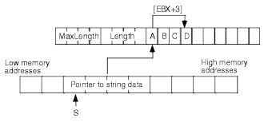
String Related Definitions
Let P be a string of size m
A substring P[i .. j] of P is the subsequence of P consisting of the characters with ranks between i and j
A prefix of P is a substring of the type P[0 .. i]
A suffix of P is a substring of the type P[i ..m − 1]
Where i is between 0 and m -1 inclusively

Slide 6
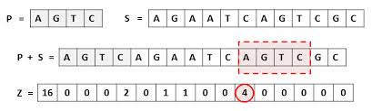
Pattern Matching
Given strings T (text) and P (pattern), the pattern matching problem consists of finding a substring of T equal to P
Applications:
Text editors
Search engines
Biological research
DNA

Slide 7
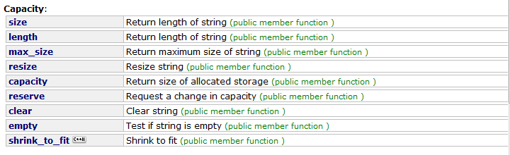
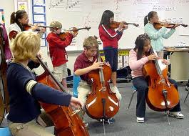
The String Class Methods (1)
See http://www.cplusplus.com/reference/string/string/

Slide 8
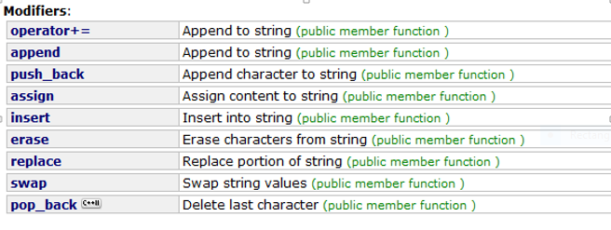
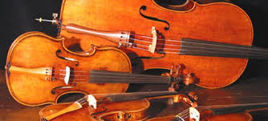
The String Class Methods (2)

Slide 9
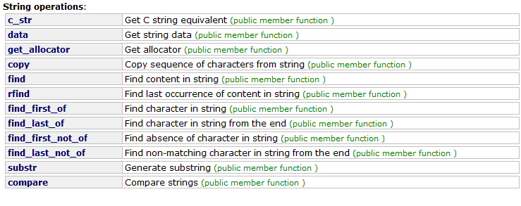
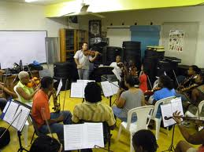
The String Class Methods (3)

Slide 10
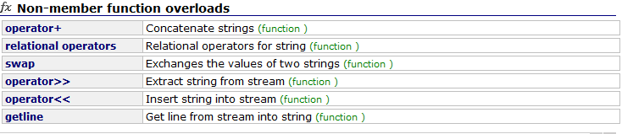
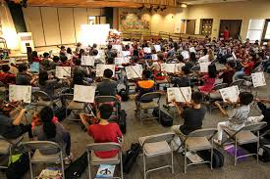
The String Class Methods (4)

Slide 11
String Methods Illustrated
Let S = ‘abcdefghijklmnop”

Slide 12
Dynamic Programming
Solving Optimization Problems

Slide 13
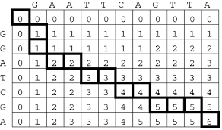
Dynamic Programming
Applies to a problem that at first seems to require a lot of time (possibly exponential) to solve but can be solved in polynomial time

Slide 14

Subsequences
A subsequence of a character string x₀x₁x₂…x_{n-1} is a string of the form x_{i1}x_{i2}…x_{ik} where ij < ij+1
Not the same as substring
Given string: ABCDEFGHIJK
Subsequence: ACEGIJK
Subsequence: DFGHK
Not subsequence: DAGH

Slide 15

The Longest Common Subsequence Problem
Given two strings X and Y
The longest common subsequence (LCS) problem is to find a longest subsequence common to both X and Y
Has applicability to DNA similarity testing
Alphabet is {A,C,G,T}
Particular piece of DNA might be AATTGCCTTTTAAAAA

Slide 16
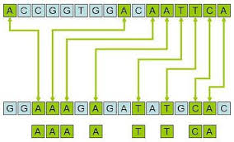
The Longest Common Subsequence (LCS) Example
Given ABCDEFG and XZACKDFWGH
ACDFG is the longest common subsequence

Slide 17

Dynamic Programming Definitions
Simple sub-problems: the sub-problems can be defined in terms of a few variables, such as j, k, l, m, and so on
Sub-problem optimality: the global optimum value can be defined in terms of optimal sub-problems
Sub-problem overlap: the sub-problems are not independent, but instead they overlap (hence, should be constructed bottom-up)

Slide 18
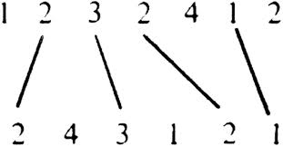
The Longest Common Subsequence (LCS) Problem
A Dynamic-Programming approach
Define L[i,j] to be the length of the longest common subsequence of X[0..i] = x₀x₁x₂x_{3…}x_{i} and Y[0..j]= y₀y₁y₂y_{3…}y_{j}
Allow for -1 as an index, so L[-1,k] = 0 and L[k,-1]=0, to indicate that the null part of X or Y has no match with the other

Slide 19
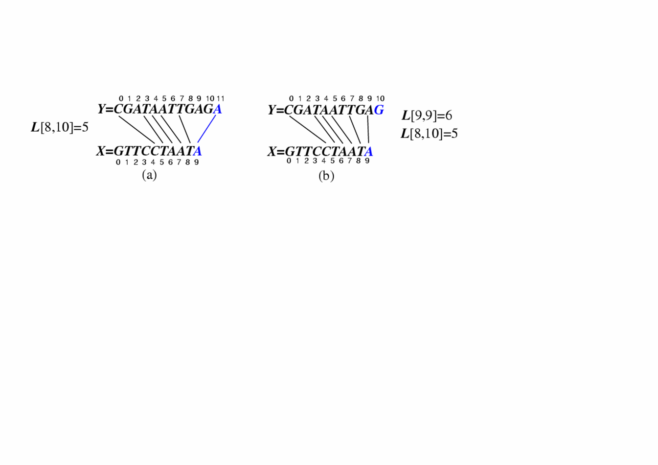
The Longest Common Subsequence (LCS) Problem
Then one defines L[i,j] in the general case as follows:
If x_{i}=y_{j}, then L[i,j] = L[i-1,j-1] + 1 (count this match) (Case 1 – last characters match)
If x_{i}≠y_{j}, then L[i,j] = max{L[i-1,j], L[i,j-1]} (no match here) (Case 2 – last characters do not match)
Note: The algorithm stores only the L[i,j] values (not the matches)
Case 1:
Case 2:

Slide 20
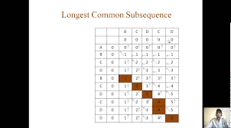
The LCS Algorithm
Algorithm LCS(X,Y ):
Input: Strings X and Y with n and m elements, respectively
Output: For i = 0,…,n-1, j = 0,...,m-1, the length L[i, j] of a longest string that is a subsequence of both the string X[0..i] = x₀x₁x₂…x_{i} and the string Y [0.. j] = y₀y₁y₂…y_{j}
for i =1 to n-1 do
L[i,-1] = 0
for j =0 to m-1 do
L[-1,j] = 0
for i =0 to n-1 do
for j =0 to m-1 do
if x_{i} = y_{j} then
L[i, j] = L[i-1, j-1] + 1 (count the match)
else
L[i, j] = max{L[i-1, j] , L[i, j-1]} (no match)
return array L

Slide 21
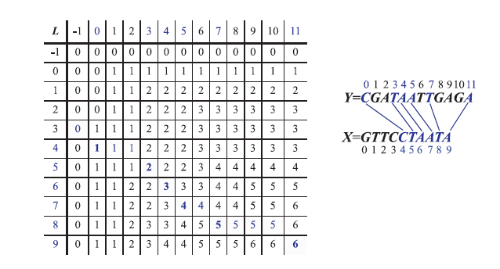
Visualizing the LCS Algorithm
X
G
T
T
C
C
T
A
A
T
A
See Figure 12.2
Y
C G A T A A T T G A G A

Slide 22

Performance of the LCS Algorithm
We have two nested loops
The outer one iterates n times
The inner one iterates m times
A constant amount of work is done inside each iteration of the inner loop
Thus, the total running time is O(nm)
The answer is contained in L[n,m] (and the subsequence can be recovered from the L table)
See LCS example

Slide 23
Pattern Matching

Slide 24

Pattern Matching Problem
Given a text string T of length n and a pattern string P of length m
Determine if P is a substring of T

Slide 25

Brute-Force Pattern Matching
The brute-force pattern matching algorithm compares the pattern P with the text T for each possible shift of P relative to T, until either
A match is found or all placements of the pattern have been tried
The brute-force pattern matching algorithm
Widespread usage
Not very efficient

Slide 26

One Approach to the LCS Problem
The brute-force solution
Enumerates all subsequences of T
Tests which ones are also subsequences of P
Picks the longest one
The brute-force solution analysis:
If T is of length n, then it has 2^{n} subsequences
This is an exponential-time algorithm!

Slide 27

Finding Divisors by Brute-Force
A brute-force algorithm to find the divisors of a natural number would enumerate all integers from 1 to the square root of n, and check whether each of them divides n without remainder

Slide 28

Brute-Force Pattern Matching
Text search:
T (text)= aaa … ah
P (pattern) = aaah
Looks for substrings of T that match P

Slide 29
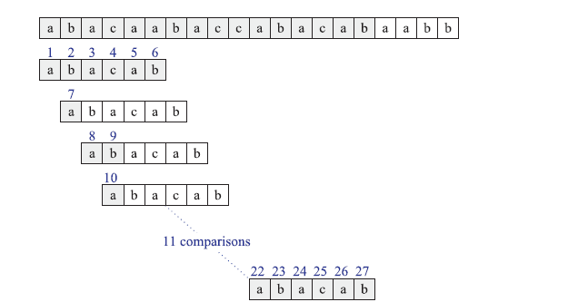
Brute Force Example
Start with the first character
Start with the second character
Start with the third character
Start with the fourth character
Is this correct? See next page

Slide 30
Brute Force Example

Slide 31
Brute-Force Pattern Matching Algorithm
Algorithm BruteForceMatch(T, P)
Input text T of size n and pattern P of size m
Output starting index of a substring of T equal to P or −1 if no such substring exists
for i ← 0 to n − m
{ for each candidate in T } do
j ← 0
while j < m and T[i + j] = P[j]
j ← j + 1
if j = m
return i {match at i}
}
return -1 {no match anywhere}

Slide 32

Brute-Force Pattern Performance
Simple algorithm - exhaustive search
Two nested loops
Outer loop indexing through all possible starting indices of the pattern in the text
Inner loop indexing through each character of the pattern comparing it to its potentially corresponding character
Brute-force pattern matching runs in time O(nm)

Slide 33

Boyer-Moore Algorithm
It is not always necessary to examine every character in T to locate a pattern P as a substring
Assumes the alphabet is finite
Best used when the pattern is relatively long
Ideal for searching words in documents
Improves the running time of the brute force method
Avoids comparisons

Slide 34

Boyer-Moore Algorithm Heuristics (1)
Looking-glass heuristic
Begin the comparisons from the end of P (pattern) and move backwards to the front of P

Slide 35
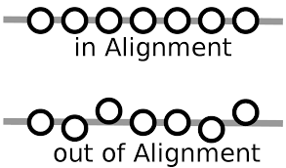
Boyer-Moore Algorithm Heuristics (2)
Character-jump heuristic
When a mismatch occurs at T[i] = c
If c is not contained in P, then shift P completely past T[i] (for it cannot match any character in P)
Otherwise shift P until an occurrence of c in P gets aligned with T[i]

Slide 36
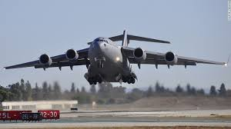
last(c)
One defines a function called last(c) that takes a character from the alphabet and characterizes how far one may shift the pattern P if a character equal to c is found in the text that does not match the pattern
If c is in P, last(c) is the index of the last (right most) occurrence of c in P
Otherwise last(c) equals -1

Slide 37

last(c)
The method for computing the table runs in O(m + size of the alphabet) time

Slide 38
The Boyer-Moore Algorithm
Algorithm BoyerMooreMatch(T, P)
compute function last
i ← m - 1
j ← m - 1
repeat
if T[i] = P[j]
if j = 0
return i { match at i }
else
i ← i - 1
j ← j - 1
else
{ character-jump }
i ← i + m – min(j, 1 + last(T[i])
j ← m - 1
until i > n - 1
return -1 { no match }

Slide 39
The Boyer-Moore Algorithm Jumps
Case 2: l + l ≤ j
Pattern is shifted j – 1 units
where l = last(T[i]) and m is the length of the pattern
Case 1: j < 1 + l
Pattern is shifted one unit

Slide 40
Boyer-Moore Example
See next page
When a mismatch occurs at T[i] = c
If P contains c, shift P to align the last occurrence of c in P with T[i]
else, shift P to align P[0] with T[i + 1]

Slide 41
Boyer-Moore Example

Slide 42
Another Boyer-Moore Example
When a mismatch occurs at T[i] = c
If P contains c, shift P to align the last occurrence of c in P with T[i]
else, shift P to align P[0] with T[i + 1]

Slide 43
Another Boyer-Moore Example

Slide 44
Boyer-Moore Performance
Boyer-Moore’s algorithm runs in time O(nm + s)
s is the alphabet size
Example of worst case:
T = aaa … a
P = baaa
The worst case may occur in images and DNA sequences but is unlikely in English text
Boyer-Moore’s algorithm is significantly faster than the brute-force algorithm on English text

Slide 45
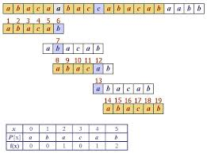
The KMP Algorithm
Knuth-Morris-Pratt’s algorithm compares the pattern to the text in left-to-right, but shifts the pattern more intelligently than the brute-force algorithm

Slide 46
The KMP Algorithm
When a mismatch occurs, what is the most we can shift the pattern so as to avoid redundant comparisons?
Answer: the largest prefix of P[0..j] that is also a suffix of P[1..j]
Failure function
.
.
a
b
a
a
b
x
.
.
.
.
.
a
b
a
a
b
a
j
a
b
a
a
b
a
No need to
repeat these
comparisons
Resume
comparing
here

Slide 47
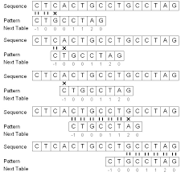
KMP Failure Function
Knuth-Morris-Pratt’s algorithm preprocesses the pattern to find matches of prefixes of the pattern within the pattern itself

Slide 48
KMP Failure Function
The failure function F(j) is defined as the size of the largest prefix of P[0..j] that is also a suffix of P[1..j]
j | 0 | 1 | 2 | 3 | 4 | 5
P[j] | a | b | a | c | a | b
F(j) | 0 | 0 | 1 | 0 | 1 | 2
Given P = abacab
F[0]= is defined to be 0
F[1] = 0 given ab
F[2] = 1 given aba
F[3] = 0 given abac
F[4] = 1 given abaca
F[5] = 2 given abacab

Slide 49
KMP Failure Function
Knuth-Morris-Pratt’s algorithm modifies the brute-force algorithm so that if a mismatch occurs at P[j] ≠ T[i] we set j ← F(j − 1)
(failure function)
j | 0 | 1 | 2 | 3 | 4 | 5
P[j] | a | b | a | a | b | a
F(j) | 0 | 0 | 1 | 1 | 2 | 3

Slide 50
The KMP Algorithm (Pseudo Code)
Algorithm KMPMatch(T, P)
F ← failureFunction(P)
i ← 0
j ← 0
while i < n
if T[i] = P[j]
if j = m − 1
return i − j { match }
else
i ← i + 1 (get next character)
j ← j + 1 (get next character)
else
if j > 0
j ← F[j − 1]
else
i ← i + 1 (get next character)
return −1 { no match }

Slide 51
The KMP Algorithm Implemented
int KMPmatch(const string& text, const string& pattern) {
int n = text.size();
int m = pattern.size();
std::vector<int> fail = computeFailFunction(pattern);
int i = 0; // text index
int j = 0; // pattern index
while (i < n) {
if (pattern[j] == text[i]) {
if (j == m - 1)
return i - m + 1; // found a match
i++; j++;
}
else if (j > 0) j = fail[j - 1];
else i++;
}
return -1; // no match
}

Slide 52

Computing the Failure Function
The failure function can be represented by an array or a vector and can be computed in O(m) time
The construction is similar to the KMP algorithm itself
At each iteration of the while-loop, either
i increases by one, or
the shift amount i - j increases by at least one (observe that F(j - 1) < j)
Hence, there are no more than 2m iterations of the while-loop

Slide 53
Computing the Failure Function
Algorithm failureFunction(P)
F[0] ← 0
i ← 1
j ← 0
while i < m
if P[i] = P[j]
{we have matched j + 1 chars}
F[i] ← j + 1
i ← i + 1
j ← j + 1
else if j > 0 then
{use failure function to shift P}
j ← F[j − 1]
else
F[i] ← 0 { no match }
i ← i + 1

Slide 54
KMP Example (Details)
j | i | P(j) | T(i) | Comparison | Compare number | Notes
0 | 0 | a | a | match | 1 | P=abacab
1 | 1 | b | b | match | 2 | T=abacaabaccabacabaabb
2 | 2 | a | a | match | 3
3 | 3 | c | c | match | 4
4 | 4 | a | a | match | 5
5 | 5 | b | a | no match | 6 | j=F(4)
1 | 5 | b | a | no match | 7 | j=F(0)
0 | 5 | a | a | match | 8
1 | 6 | b | b | match | 9
2 | 7 | a | a | match | 10
3 | 8 | c | c | match | 11
4 | 9 | a | c | no match | 12 | j=F(3)
0 | 9 | a | c | no match | 13 | i=i+1 when j=0
0 | 10 | a | a | match | 14
1 | 11 | b | b | match | 15
2 | 12 | a | a | match | 16
3 | 13 | c | c | match | 17
4 | 14 | a | a | match | 18
5 | 15 | b | b | match | 19
j | 0 | 1 | 2 | 3 | 4 | 5
P[j] | a | b | a | c | a | b
F(j) | 0 | 0 | 1 | 0 | 1 | 2

Slide 55
KMP Example
j | 0 | 1 | 2 | 3 | 4 | 5
P[j] | a | b | a | c | a | b
F(j) | 0 | 0 | 1 | 0 | 1 | 2

Slide 56
The KMP Algorithm Performance
The failure function can be represented by an array and can be computed in O(m) time
At each iteration of the while-loop, either
i increases by one, or
The shift amount i - j increases by at least one (observe that F(j - 1) < j)
Hence, there are no more than 2n iterations of the while-loop
Thus, KMP’s algorithm runs in optimal time O(m + n)

Slide 57
The Greedy Method and Text Compression

Slide 58
The Greedy Method (1)
Design patterns that are applied to optimization problems where one is trying to construct some structure while minimizing or maximizing some property
One proceeds by constructing a sequence of choices
The sequence starts from some well-understood starting condition and computes to the associated cost

Slide 59

The Greedy Method (2)
One iteratively makes additional choices by identifying the decision that achieves the best cost improvement
This approach doesn’t always lead to an optimal solution

Slide 60

The Greedy Method (3)
It works best when applied to problems with the greedy-choice property
A globally-optimal solution can be reached by a series of local improvements from a well-defined starting configuration

Slide 61

The Greedy Method Summarized
The greedy method is a general algorithm design paradigm, built on the following elements:
Configurations
Different choices, collections, or values to find
Objective function
A score assigned to configurations, which we want to either maximize or minimize

Slide 62
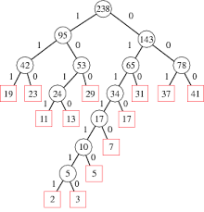
Huffman Coding (Greedy Method)

Slide 63
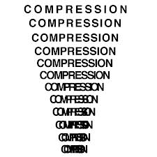
Text Compression
Given a string X, efficiently encode X into a smaller string Y
Saves memory and/or bandwidth
A good approach: Huffman encoding
Computes frequency f(c) for each character c
Encodes high-frequency characters with short code words
No code word is a prefix for another code
Uses an optimal encoding tree to determine the code words

Slide 64

Huffman Coding Details (1)
Uses a technique called lossless data compression
Variable length code table for encoding a source symbol (such as a character in a file) where the variable-length code table has been derived in a particular way based on the estimated probability of occurrence for each possible value of the source symbol

Slide 65

Huffman Coding Details (2)
Uses a specific method for choosing the representation for each symbol, resulting in a prefix code (sometimes called "prefix-free codes)"
The bit string representing some particular symbol is never a prefix of the bit string representing any other symbol
Expresses the most common source symbols using shorter strings of bits than are used for less common source symbols

Slide 66

Huffman Coding Details (3)
This is the most efficient compression method of this type
No other mapping of individual source symbols to unique strings of bits will produce a smaller average output size when the actual symbol frequencies agree with those used to create the code
Averages 25% savings in storage space and network traffic
Can be up to 55 – 60% savings in storage space

Slide 67
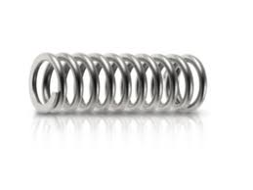
Huffman Coding Technique (1)
The technique works by creating a binary tree
The size depends on the number of symbols
A node can be either a leaf node or an internal node
Initially, all nodes are leaf nodes, which contain the symbol itself, the weight (frequency of appearance) of the symbol and optionally, a link to a parent node

Slide 68
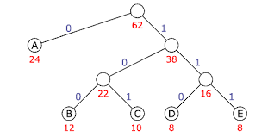
Huffman Coding Technique (2)
All internal nodes contain
Symbol weights
Links to two child nodes
Optional link to a parent node
As a common convention, bit '0' represents following the left child and bit '1' represents following the right child
A finished tree has up to n leaf nodes and n-1 internal nodes

Slide 69
Encoding Tree Example
A code is a mapping of each character of an alphabet to a binary code-word
A prefix code is a binary code such that no code-word is the prefix of another code-word
An encoding tree represents a prefix code
Each external node stores a character
The code word of a character is given by the path from the root to the external node storing the character (0 for a left child and 1 for a right child)
00 | 010 | 011 | 10 | 11
a | b | c | d | e
a
d
e
Decode 010111101100
b
c

Slide 70
Encoding Tree Optimization
Given a text string X, we want to find a prefix code for the characters of X that yields a small encoding for X
High frequency characters should have short code-words
Rare characters should have long code-words
Example
X = abracadabra
T₁ encodes X into 29 bits
T₂ encodes X into 24 bits
Draw the Huffman coding
conversion tables
T₁
T₂
c
d
b
a
b
r
a
r
c
d

Slide 71
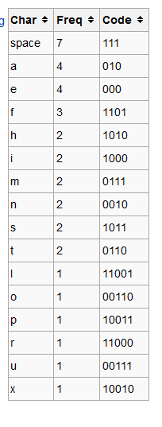
Sample Huffman Coding Conversion Table

Slide 72

Decode and Draw the Binary Tree
Decode 010011110001011000100011

Slide 73

Huffman Coding Algorithm (1)
Uses a priority queue where the node with lowest probability is given highest priority
Creates a leaf node for each symbol and adds it to the priority queue

Slide 74
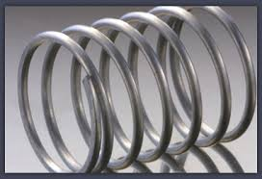
Huffman Coding Algorithm (2)
2. While there is more than one node in the queue:
Remove the two nodes of highest priority (lowest frequency) from the queue
Create a new internal node with these two nodes as children and with frequency equal to the sum of the two nodes' frequencies
Add the new node to the queue
3. The remaining node is the root node and the tree is complete

Slide 75
Building a Huffman Tree Example (1)
Sort this list by frequency and make the two-lowest elements into leaves, creating a parent node with a frequency that is the sum of the two lower element's frequencies
12
A
B
5
7

Slide 76
Building a Huffman Tree Example (2)
Repeat the loop, combining the two lowest elements…..
22
12
A
B
C
5
7
10

Slide 77
Building a Huffman Tree Example (3)
Repeat the loop, combining the two lowest elements
22
12
35
A
B
C
D
E
5
7
10
15
20

Slide 78
Building a Huffman Tree Example (4)
Repeat the loop, combining the two lowest elements
57
22
12
35
A
B
C
D
E
5
7
10
15
20

Slide 79
Building a Huffman Tree Example (5)
Repeat the loop, combining the two lowest elements
102
57
22
12
35
A
B
C
D
E
F
5
7
10
15
20
45

Slide 80
Adding Frequencies
11
X = abracadabra
5
6
Frequencies
2
4
a | b | c | d | r
5 | 2 | 1 | 1 | 2
a
c
d
b
r
6
2
4
a
b
c
d
r
5
2
1
1
2
a
c
d
b
r
5
2
2
4
a
b
c
d
r
a
c
d
b
r
5
2
2
5

Slide 81
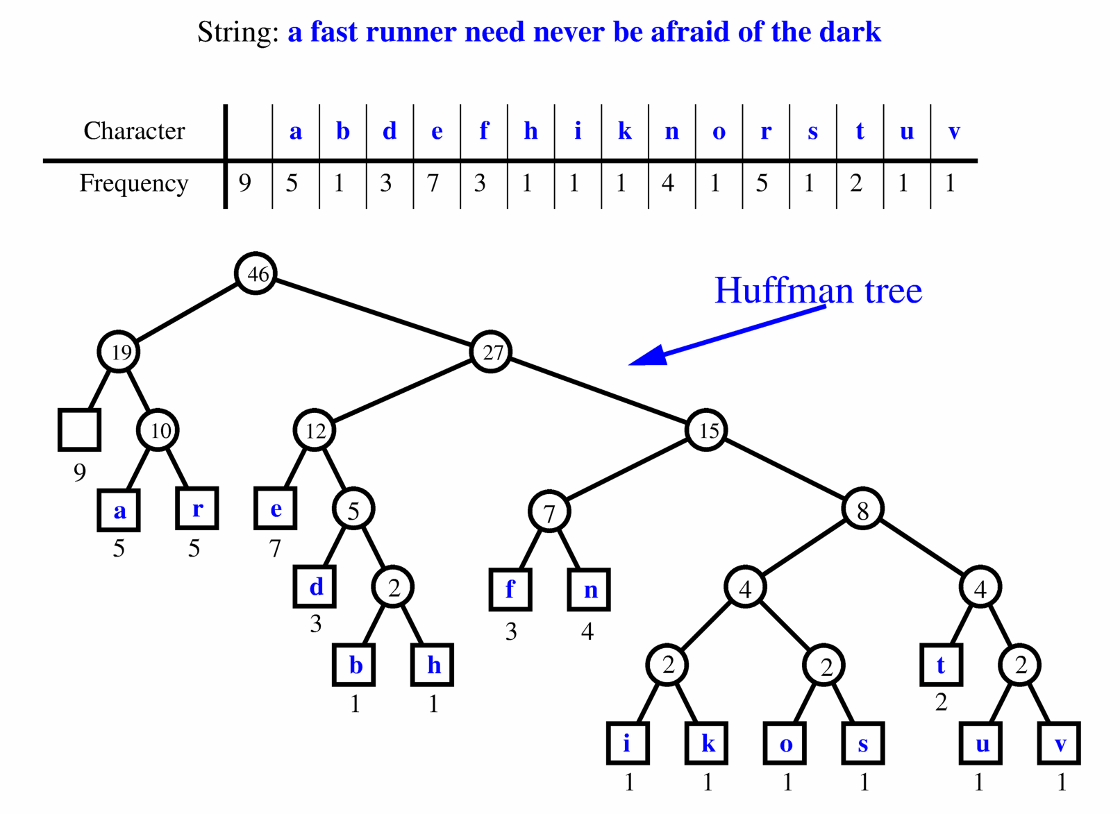
Extended Huffman Tree Example
This example doesn’t follow the previous algorithm

Slide 82
Building a Huffman Tree
Given the following distribution, construct a Huffman tree and the associated codes generated

Slide 83
Huffman’s Algorithm
Algorithm HuffmanEncoding(X)
Input string X of size n
Output optimal encoding trie for X
C ← distinctCharacters(X)
computeFrequencies(C, X)
Q ← new empty heap
for all c ∈ C
T ← new single-node tree storing c
Q.insert(getFrequency(c), T)
while Q.size() > 1
f₁ ← Q.minKey()
T₁ ← Q.removeMin()
f₂ ← Q.minKey()
T₂ ← Q.removeMin()
T ← join(T₁, T₂)
Q.insert(f₁ + f₂, T)
return Q.removeMin()

Slide 84
Huffman’s Algorithm Analysis
Given a string X, Huffman’s algorithm constructs a prefix code the minimizes the size of the encoding of X
It runs O(n + d log d) in time, where n is the size of X and d is the number of distinct characters of X
A heap-based priority queue is used as an auxiliary structure

Slide 85

Preprocessing Strings

Slide 86
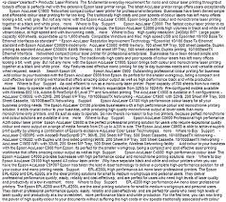
Preprocessing Strings
Preprocessing the pattern speeds up pattern matching queries
After preprocessing the pattern, KMP’s algorithm performs pattern matching in time proportional to the text size
If the text is large, immutable and searched often (e.g., works by Shakespeare), one may want to preprocess the text instead of the pattern

Slide 87
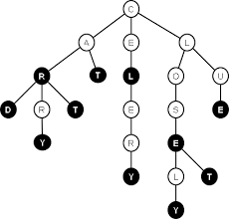
Trie
A trie (also called digital tree, radix tree or prefix tree) is a compact data structure for representing a set of strings, such as all the words in a text
A trie supports pattern matching queries in time proportional to the pattern size

Slide 88
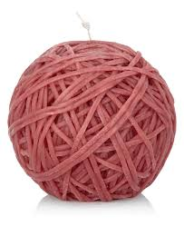
Strings
Let S be set of strings from an alphabet such that no string is a prefix of another string

Slide 89
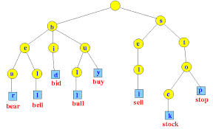
Standard Tries
A standard trie for a set of strings S is an ordered tree such that:
Each node but the root is labeled with a character of the alphabet
The children of a node are alphabetically ordered
The paths from the external nodes to the root yield the strings of S

Slide 90
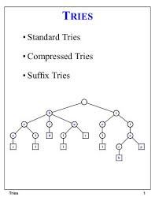
Standard Tries
An internal node in a standard trie can have anywhere between 1 and d children
Where d is the size of the alphabet
There is an edge going from the root to one of its children for each character that is the first character in some string
If there are only two characters in the alphabet, the trie is a binary tree

Slide 91

Standard Tries
A trie, T, for a set of strings can be used to implement a dictionary whose keys are the strings
Tries are used to perform a special type of pattern matching
Word matching (entire words)

Slide 92
Standard Tries Illustrated
Example: standard trie for the set of strings
S = { bear, bell, bid, bull, buy, sell, stock, stop }
Each string is uniquely associated with an external node

Slide 93
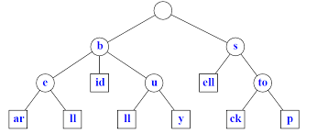
Proposition 12.8
A standard trie,T, storing a collection of s strings of total length n from an alphabet of size d has the following properties
Every internal node has at most d children
T has s external nodes
The height of T equals the length of the longest string
The number of nodes of T is O(n)

Slide 94
Analysis of Standard Tries
A standard trie uses O(n) space and supports searches, insertions and deletions in time O(dm), where:
n - total size of the strings in S
m - size of the string parameter of the operation
d - size of the alphabet

Slide 95
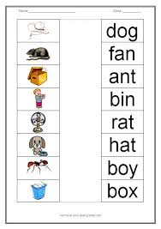
Word Matching with a Trie
One inserts the words of the text into a trie
Each leaf stores the occurrences of the associated word in the text (first character)

Slide 96
Construction of a Trie
One uses an incremental algorithm that inserts the strings one at a time
To insert a string X into T
One first tries to trace the path associated with X
Since X is not already in T (no string can be a prefix of another string), one stops tracing the path an internal node v before reaching the end of X
One then creates a new chain of node descendants to store the remaining characters of X

Slide 97
Construction of a Trie Illustrated

Slide 98
Compressed Tries
A compressed trie has internal nodes of degree at least two
It is obtained from standard trie by compressing chains of “redundant” nodes
A node is redundant if it has one child and is not the root
5
3
7
1
2
4
6
8
There are Eight Redundant Nodes

Slide 99
Compressed Tries
One transforms T into a compressed trie by replacing the redundant nodes with a concatenation of nodes
5
3
7
Saves space
1
2
4
6
8

Slide 100
Compact Representation (1)
Compact representation of a compressed trie for an array of strings:
Stores at the nodes ranges of indices instead of substrings
Uses O(s) space instead of O(n), where s is the number of strings in the array
Serves as an auxiliary index structure

Slide 101
Compact Representation (2)
(index, beginning character position, ending character position)
s
e
to
e
ll
p

Slide 102
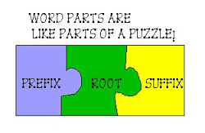
Suffix Tries
Another application of tries is when the strings of a collection are all suffices of a string X
Called a suffix trie (ordered tree), suffix tree or position tree
Rule: No suffix is a prefix of another suffix

Slide 103
Suffix Trie
The following shows the suffix trie for the eight suffices of minimize
Figure 12.13a

Slide 104
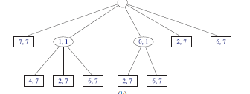
Compact Suffix Trie
Given
Figure 12.13b
Draw the compact suffice trie for abaabas (construct the un-compressed Trie first)

Slide 105
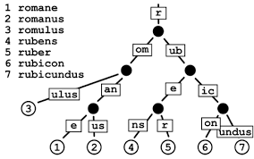
Using a Suffix Trie
Can be used efficiently of perform pattern matching queries on a text
One can determine whether a pattern P is a substring to by trying to trace a path associated with P within the suffix trie
P is a substring of a string if and only if such a path can be traced

Slide 106

Analysis of Suffix Tries
Compact representation of the suffix trie for a string X of size n from an alphabet of size d
Uses O(n) space
Supports arbitrary pattern matching queries in X in O(dm) time, where m is the size of the pattern
Can be constructed in O(n) time

